Slide 1

Name
Institution
Date
Trademark Law

Slide 2
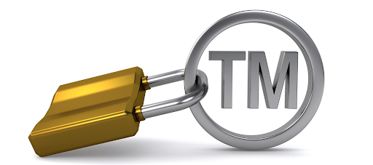
Two Pesos, Inc. v. Taco Cabana, Inc.
This was a United States Supreme Court trademark law case.
Taco Cabana, Inc., in this case was the respondent.
The petitioner of the case was Two Pesos, Inc.
Notes:
Taco Cabana, Inc. operated a chain of Mexican restaurants while Two Pesos, Inc. with a similar chain.
In this trademark law case, Taco Cabana, the respondent had sued Two Pesos, Inc., the petitioner for the infringement of trade dress under § 43(a) of the Trademark Act of 1946 (Lanham Act).
This act provides that any person using in connection with any goods or services any description or representation that is false shall be liable to any person damage by such use.

Slide 3
Why this case choice
This case will improve my trademark law understanding.
The case will help me understand the concept of trade dress.
Notes:
A trademark is a way that is used in order to distinguish service or product.
A mark in order to be registered must be capable to distinguish goods of the applicant from the others.
Categories of generally increasing distinctiveness are used in classification of marks. The classic formulation set out by Judge Friendly are generic, descriptive, suggestive, arbitrary and fanciful. The first tree categories of marks are considered to be intrinsic in nature and serve in identifying a particular product source and therefore are inherently deemed distinctive and therefore entitled to protection. On the other hand, marks that are generic are unregistered as trademarks.
Under 43(a), there is protection of trade dress. Trade dress is the total business image and appearance.

Slide 4
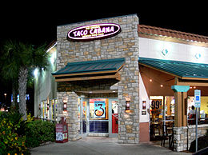
Notes:
The above picture shows the Taco Cabana in Dallas trade dress.

Slide 5
I will also understand how one company can infringe the trademark of another.
Notes:
The trademark of Taco Cabana, Inc. was infringed by Two Pesos, Inc.
Two Pesos, Inc. was able to infringe the trademark by just copying the design of Taco Cabana Inc.

Slide 6
The case
Two Pesos, Inc. was sued by Taco Cabana, Inc. for infringement of trade dress.
§ 43(a) of the Trademark Act of 1946 (Lahman Act) applies.
Notes:
Any person who uses description or representation of a business which is false in connection with any goods or services shall be liable to such use personal damage under § 43(a) of the Trademark Act of 1946 (Lahman Act) applies.
Under 43(a) the jury was instructed by the District Court that the trade dress was protected if either was inherently distinctive or had acquired a secondary meaning or an association that was unique with a specific source.
Trade dress refers to the business total image and appearance.

Slide 7
Taco Cabana trade dress was inherently distinctive.
Damages were awarded to Taco Cabana in the judgment.
Notes:
The trade dress of Taco Cabana, Inc. was found by the jury to be inherently distinctive but had not acquired a secondary meaning.
The jury had been told that the trade dress of Taco Cabana was protected if it either was inherently distinctive or had acquired a secondary meaning.
The judgment was therefore entered awarding Taco Cabana damages.

Slide 8
Taco Cabana’s trade dress has been deliberately and intentionally infringed by Two Pesos.
Notes:
The trial court when calculating damages held that Two Pesos had deliberately and intentionally infringed the trade dress of Taco Cabana.
However, despite Two Pesos appealing, the Court of Appeal ruled their instructions stated adequately the applicable law and the evidence supported the findings of the jury.
The argument of the petitioner, Two Pesos were rejected by the Court of Appeal as the petitioner had argued that a finding of no secondary meaning contradicted inherent distinctiveness finding.

Slide 9
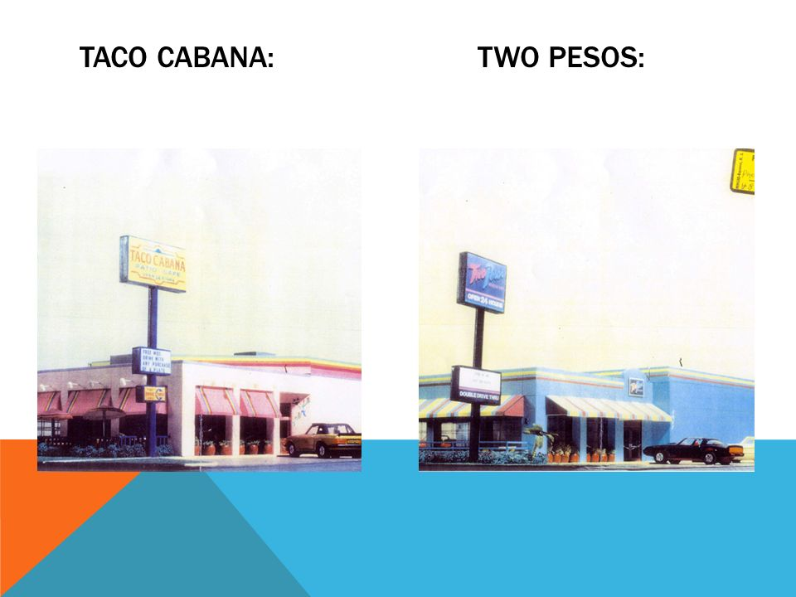
Trade dress
Notes:
The picture shown in the above slide shows how Two Pesos, Inc. infringed the Taco Cabana, Inc. trademark.
Two Pesos Inc. has exactly copied the design of Taco Cabana, Inc. which was a Mexican restaurants operator.

Slide 10
Lanham Act
Prohibits use of marks which is misleading and deceptive.
Notes:
The Lanham Act prohibits the use of marks which is misleading and deceptive.
The act also protect business owners against competition which is unfair.
Lanham Act defines trademarks as "any word, name, symbol, or device or any combination thereof" used by any person "to identify and distinguish his or her goods, including a unique product, from those manufactured or sold by others and to indicate the source of the goods, even if that source is unknown.“
“A trademark is considered ‘distinctive and capable of being protected’ if it ‘either (1) is inherently distinctive or (2) has acquired distinctiveness through secondary meaning.’ However, a claim for trademark infringement requires ‘proof of the likelihood of confusion’. ”

Slide 11
Outcome
The trademark of Taco Cabana, Inc was infringed by Two Pesos, Inc.
Notes:
This infringement was by where the design of Taco Cabana, Inc had been copied by Two Pesos, Inc.
The trade dress is exactly what had been infringed where Two Pesos copied Taco Cabana business image and appearance.
The conclusion of Justice Byron white was that trade dress under the Lahman Act is inherently distinctive and that no need for proving secondary meaning in suits to protect trademark by the plaintiffs.
The court upheld an award of $3.7 million in damages and ultimately all of assets owned by two Pesos, Inc. were acquired by Taco Cabana for $22 million in 1993.

Slide 12

My opinion
By referring to the Lanham Act on the trademarks protection, I fully agree with the outcome of the case. (In Barfield & In Blitz, 2018)
Notes:
Copying the restaurants design, Two Pesos had infringed trade dress of Taco Cabana, Inc. and Justice Byron White concluded what my judgment would have been where the plaintiffs are not required to prove secondary meaning in suits in their trademark protection.
I am okay with the damages awarded as well as Taco Cabana ultimately acquiring all assets of Two Pesos meant well for the two restaurants.

Slide 13
References
Raysman, R., & Raysman, R. (2002). Emerging technologies and the law: Forms and analysis. New York, N.Y: Law Journal Press.
In Barfield, W., & In Blitz, M. J. (2018). Research handbook on the law of virtual and augmented reality.
http://www.casesofinterest.com/tiki/Two+Pesos+Inc.+v+Taco+Cabana+Inc.
https://www.lexisnexis.com/community/casebrief/p/casebrief-two-pesos-inc-v-taco-cabana-inc
https://www.casebriefs.com/blog/law/intellectual-property-law/intellectual-property-keyed-to-merges/trademark-law/two-pesos-inc-v-taco-cabana-inc-2/

